Slide 1
Week 07

Slide 2
Updates
Lab 05 - Due tonight (10/5), else10% off per day until Friday, 9/30
Lab 06 - Due Monday 10/11
Quiz 3 - this Thursday 10/7
Midterm Review - 10/12
Midterm - 10/14
1.5 hours once started
1 attempt
Open 8:00 AM - 11:59 PM

Slide 3
Notes from last time
Pressing power button triggers CPU with instruction to load BIOS / UEFI
BIOS / UEFI - ROM chip on motherboard
Performs POST
Lists disks with partition tables
Select a disk (or uses a default disk)
BIOS loads partition table into RAM
MBR vs GPT
First partition starts its bootloader
BootMgr (Windows), GRUB (Linux)
Bootloader loads kernel into RAM
Kernel takes control, starts processes to load and run OS

Slide 4
Kernels
Interface between hardware and OS
Memory management:
Keep track of how much memory is used to store what, and where
Process management:
Determine which processes can use the central processing unit (CPU), when, and for how long
Device drivers:
Act as mediator/interpreter between the hardware and processes
System calls and security:
Receive requests for service from the processes
Notes:
https://www.redhat.com/en/topics/linux/what-is-the-linux-kernel

Slide 5

Linux Kernel
The kernel is the version number - the core of the system
OS is the “Pretty Name” that determines how the user space runs
https://distrowatch.com/

Slide 6
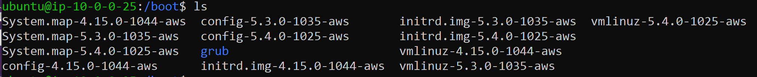
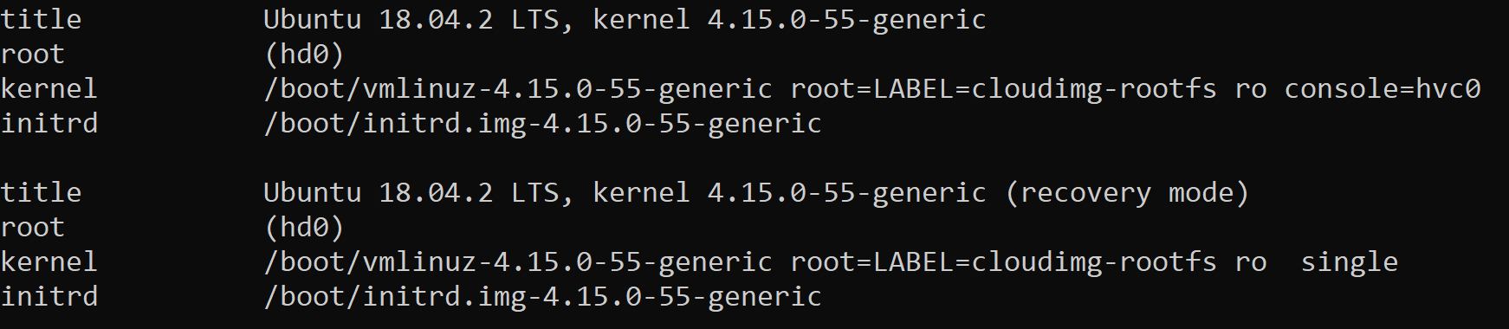
The Kernels
The GRUB Menu

Slide 7
Windows Kernel
Winload.exe (Windows Boot Loader) is a small piece of software, called a system loader, that's started by BOOTMGR, the boot manager used in Windows 10, Windows 8, Windows 7, and Windows Vista operating systems.
The job of winload.exe is to load essential device drivers, as well as ntoskrnl.exe, a core part of Windows.
Notes:
https://www.lifewire.com/what-is-winload-exe-2626051

Slide 8
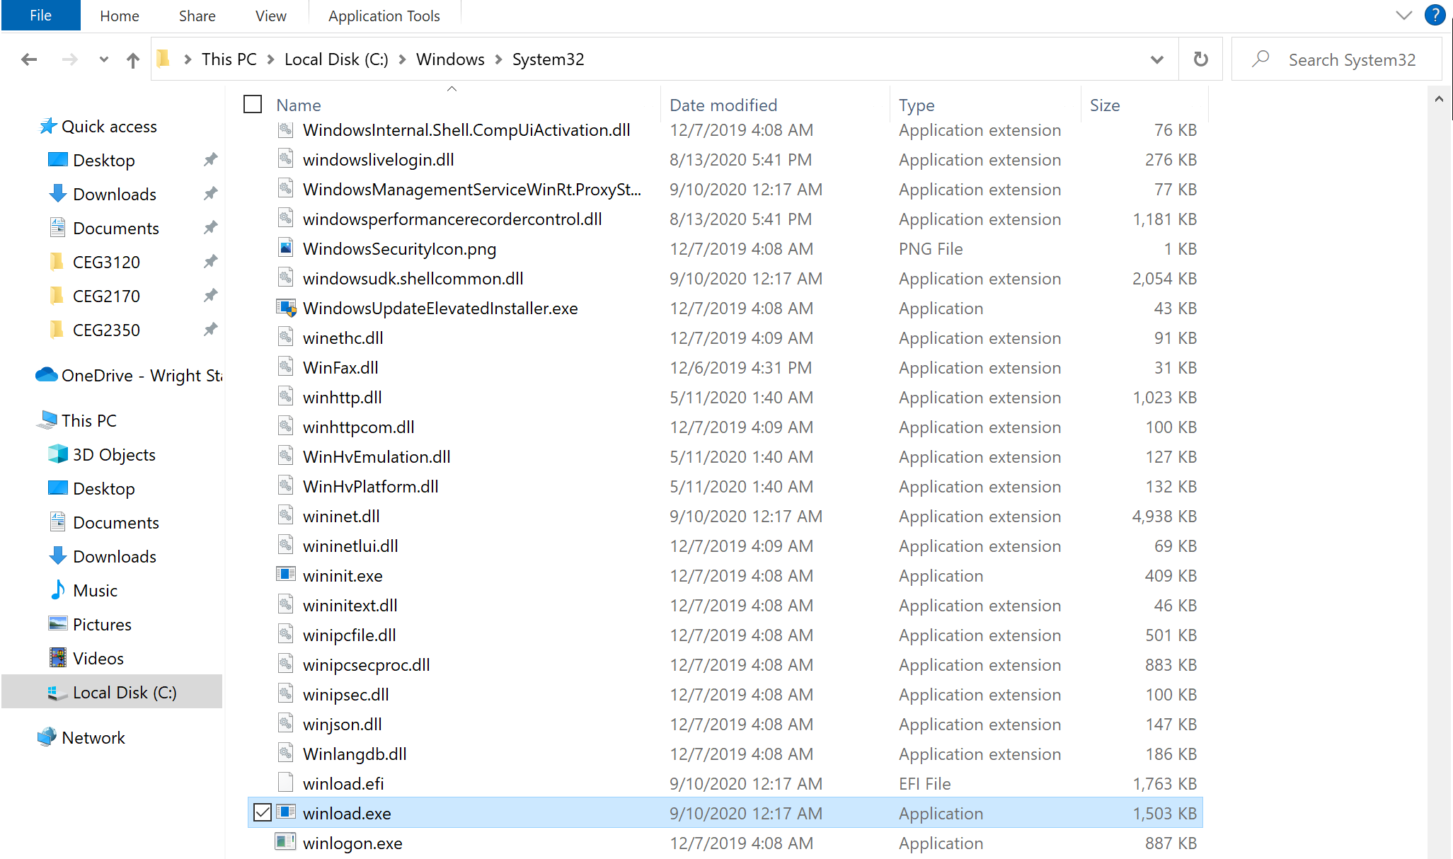
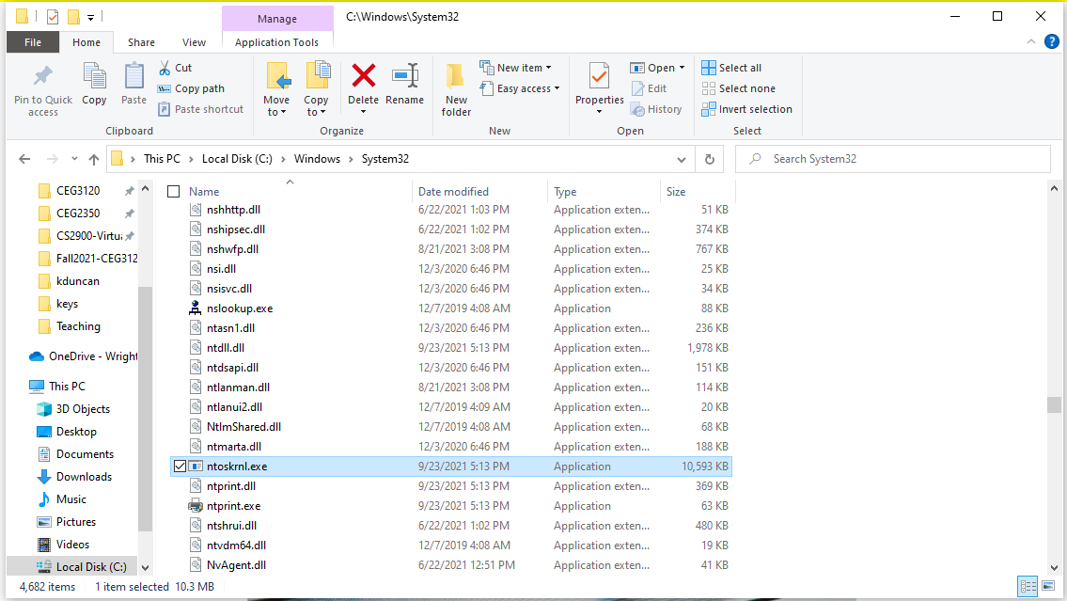

Slide 9
Hello to the OS
A set of processes that you give you the experience you are used to
Licensed Oses
Windows
PS. You can get an educational license as a student
Mac
And usually “locked” to running only on Apple hardware
RedHat linux
Enterprise level uber stable Linux - full paid development team
No license needed
Unix OSes
Linux Oses
These are usually referred to as distributions

Slide 10
Virtualizing the Machine
Experience via Virtual Machines

Slide 11
The idea
To understand the boot process, you should probably build something from scratch at some point
However, asking you to nuke your machine and reinstall would be… inconvenient
Buying each of you a new PC would be expensive
So
Virtualized hardware on which you can install an OS

Slide 12
Definition of a VM
Virtual Machines require hypervisors
Hypervisors make sure the guest gets its “share” of hardware resources
Host - the machine and OS that load when you turn on the system
Guest - the virtualized machine that can be turned “on” and “off” independently of the host

Slide 13
Needs
CPU with virtualization
When you create a VM, you define its set of hardware resources it can use
CPU
RAM
Disk space
For those wondering, you can also define if it can use GPU resources
This is not as nice as you think, and limited in capability
But good for offloading visual tasks off the host CPU

Slide 14
Check for Virtualization Support
Windows:
https://www.technorms.com/8208/check-if-processor-supports-virtualization
Linux:
https://www.linux.com/training-tutorials/create-and-run-virtual-machines-virt-manager/
Mac:
https://build5nines.com/check-hyper-v-intel-vt-x-virtualization-support-on-macos-computer/

Slide 15
VirtualBox
https://www.virtualbox.org/wiki/Downloads
This is the virtual machine manager we will focus on
Others exist: VMWare and Parallels are some other big names

Slide 16
Creating a virtual machine
Before you can install an OS, you need to set the hardware the machine will run on
ie. Your laptop must exist before it can have an OS
Determine how much:
RAM
Keep in mind your host also uses RAM, so pick fairly
CPU
Keep in mind your host also uses CPU, so pick fairly
Disk space
And whether that disk is finite or allowed to grow
Note: disks don’t normally “grow”

Slide 17
Installing a VM
Pick an iso (optical disk image)
An iso is a complete copy of everything stored on a physical optical disc like CD, DVD, or Blu-ray disc
ISO images these days are used primarily for distributing large programs and operating systems, because it allows all the files to be contained in one easily downloadable file
An iso does not necessarily contain the full OS. It is usually designed as an installation media, and may ask for internet access

Slide 18
Note: VM vs Real World
In the real world, you would download your iso, then create a BOOTABLE disk that will boot to the FILESYSTEM on the drive
This means an iso’s contain the exact contents that need to be on the media (usually a USB)
The BIOS can detect bootable partitions on the USB, because it has a partition table, and boot to them
VirtualBox is handling this for us - we just need to specify the iso
Notes:
https://www.usbmemorydirect.com/blog/introduction-to-bootable-flash-drives/

Slide 19
What does it mean to create bootable media?
https://www.cyberciti.biz/faq/creating-a-bootable-ubuntu-usb-stick-on-a-debian-linux/

Slide 20
Where do I get an iso?
Well, what operating system would you like?
Licensing can be a problem (Windows & Mac) - Unix / Linux VMs are most common
https://distrowatch.com/
Ubuntu is a reigning “New to Linux? Start here” champion
https://ubuntu.com/download/desktop
We are using Ubuntu Server VMs in AWS
Head to their site, click download to download an iso to install the OS

Slide 21
Installing a VM
So you have hardware reserved, well, “virtualized” hardware
The disk space is a folder on your host of reserved size
The RAM will be eaten up by the Guest once you start the VM
The CPU will be virtualized (and will take up from your host) once you hit go
You now need to “plug in” your installation media (the iso)
Now start your VM

Slide 22
What’s happening on first boot?
The disk will be “skipped”
It does not have a partition table with any bootable partitions
Goes straight to iso (installation media)

Slide 23
Problem & Solution
Your virtual bios now knows the installation media was bootable.
Let’s look at the boot order in the Settings
We may need to “unplug” the installation media to have it use our disk as the thing we want to boot to first

Slide 24
More on virtual machines
There is a lot more to them:
How the networking works
How to use extended features (Guest Additions) for Virtual Box
Snapshots, cloning, etc.
For now, know there is more, and we might circle back when we chat about virtualization

Slide 25
Notes on PopOS
Move the installation window slightly (but not completely) out of the way, right-click on the desktop and select "Display Settings". From here you will be able to change the virtual machine's screen resolution. Increase the virtual machine resolution from the default 800x600 to 1024x768 or above, then click Apply in the top right-hand corner.
Partition table expands whole disk
Else swap space vs / space issue
Sometimes you have to hit enter instead of just clicking the option you want
Notes:
https://support.system76.com/articles/install-in-vm

Slide 26
Creating a bootable USB
https://www.cyberciti.biz/faq/creating-a-bootable-ubuntu-usb-stick-on-a-debian-linux/
https://www.ionos.com/digitalguide/server/know-how/make-a-bootable-usb-drive/
https://rufus.ie/en/
https://ubuntu.com/tutorials/create-a-usb-stick-on-windows#1-overview

Slide 27
QUIZ TODAY (10/7)
Open until 11:59 PM
In class video: https://www.youtube.com/watch?v=Dxnr2FAADAs&ab_channel=Valve

Slide 28
Questions I missed in chat
Once you're done with a virtual machine, do you have to manually clear all of the memory and resources you gave it? or does it do that automatically?
Once a machine is powered off, hypervisor releases resources back to the host to use - the resources are “freed” until the machine is powered on again
Where is the hypervisor in your files? Is it VirtualBox?
Hypervisor is a process that runs - it is not in your “files” so to speak, it is a process that is enabled to run
Isn’t Mac based on Unix? Why the license
Mac is based on Unix, as in they took the open source core and have since made many modification. Mac is Unix-like
Linux is also based on Unix. They had other tools and methods of development, and made their own branch

Slide 29


Slide 30
$ git clone repo_name
Downloading a local copy of a repository
$ git add filename
Adds a file to be tracked
$ git commit -a
Timestamp of changes to files in the local copy
You need to type a description of changes
$ git push
Upload the committed changes to GitHub (remote)
$ git status
Tells you what is up locally

Slide 31
Using `git pull`
Remote = the host of the repository = GitHub
Local = cloned repository
You have a local copy of your repo on your system
$ git pull
Use when changes exist on remote that don’t exist on local

Slide 32
Picture perfect example
You need to add screenshots to your lab
But you don’t have a nice way to move files from local to your cloned repo (likely on AWS)
So…
$ sftp - totally valid answer
Cheat: go to your repo in GitHub
Upload a file
Use `git pull` to update your local copy
Add to markdown
![description of photo](relative path to photo)

Slide 33
Patch up slide order for weekend
Partition tables
Partitons
Filesystem
Storing on a drive, chunking data
Inodes and blocks on a disk, blocks correspongding to sectors

Slide 34
Data on a Disk

Slide 35
The idea
You store bits on a disk (0’s and 1’s)
In terms of passing data, it would be inconventient to transfer a single bit of information. You would rather have a chunk of information to pass.

Slide 36
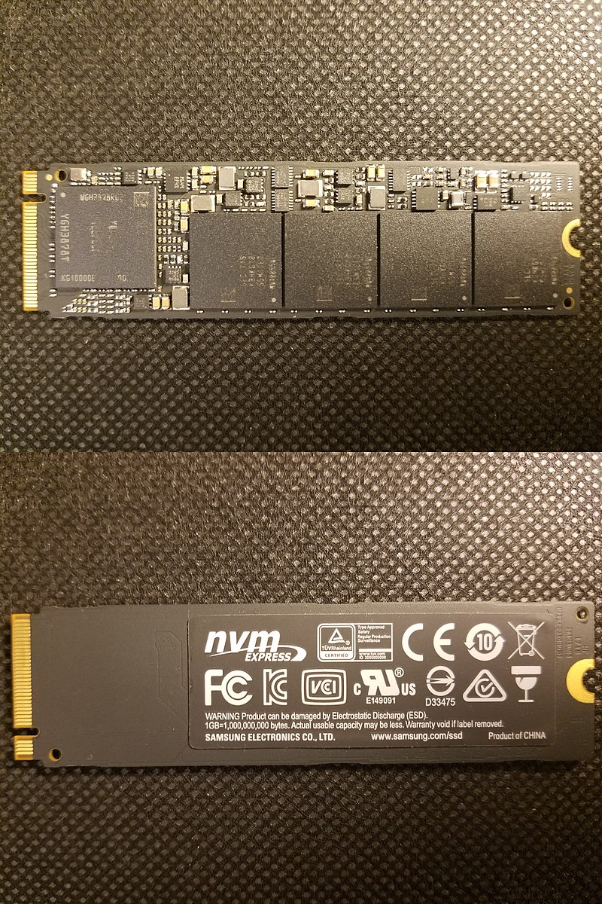

How Data Works
Data is not necessarily stored sequentially
Hard disk – spinning disk with a shaft (think of a record player)
In a Hard Drive, fragmentation needs to be considered – it takes longer to rotate the disk
You could use tools to defragment a disk – or push the file into sequential blocks
Solid State drives have a finite number of read / write cycles plus it tried to balance wear.
Your OS needs to know where your files are located
Not by directory, but by where on the disk / chip (disk I/O)
Notes:
https://en.wikipedia.org/wiki/Defragmentation#/media/File:FragmentationDefragmentation.gif

Slide 37
Blocks & sectors
A sector is a physical region on a drive
512 Bytes - 4 KB
A bad sector ~= a hardware failure
A block - a chunk of data to be read / written to
You can define block size
We will play more with this when we hit up partitioning and creating filesystems

Slide 38
Filesystem
Have a header that contains:
Which filesystem (so kernel can determine if it can read it)
The directory tree
A list of names of files and folders
A list of inodes
An inode number contains information like where the pieces of a file are physically stored on disk (which blocks).
An inode by itself is simply "a file" with no name; an inode is associated with a name via the directory tree

Slide 39
inodes
Internally, your OS doesn't care about your file names
Linux uses inodes
Windows uses file-IDs
Number of inodes != disk size
How many i-nodes are taken:
$ df –ih /
Disk size (blocks taken)
$ df -h /

Slide 40
inodes
I-nodes capture metadata about the file
Size
Date modified
Where it resides on drive (which blocks)
Every file references an inode and vice-versa
$ ls -li
First column is the inode
$ stat filename

Slide 41
inodes vs blocks
There are two resources that a file system provides to the user: blocks (for data) and inodes (for files).
Each file consumes one inode
File data is stored in data blocks on the disk
Assuming there are no directories, it is possible for a user to exceed his or her inode quota without using any blocks by creating all empty files.
Infinite use of `touch` command
It is also possible for a user to use only one inode yet exceed his or her block quota by simply creating one file large enough to consume all the data blocks in the user's quota.
Notes:
https://docs.oracle.com/cd/E19455-01/805-7229/sysresquotas-3/index.html

Slide 42
Linking
Hard link
Inode is associated with multiple file names
All files hardlinked point to the same inode & the same blocks on the disk
A change to a file changes the blocks
Soft link
A file has a inode, but it points to the inode of another file (not to blocks on a disk)
Removing the symbolic link has no effect on the real files existence
Copy
Files exist with unique inodes written to unique blocks
Move
New file name associated with inode

Slide 43
Linux - creating links
Create a file
$ ln target link_name
Check stat
$ ls --symbolic target link_name
Check stat
What type of path?
Check out --relative
What’s the problem?
Notes:
https://coffeewithbytes.com/blog/hardlink_softlink/

Slide 44
Windows – Shortcuts & Links
Symbolic links in Windows are "shortcuts"
Right click on a file to create Shortcut
Powershell:
Symbolic link
New-Item -ItemType SymbolicLink -Path "Link" -Target "Target“
Hard link
New-Item -ItemType HardLink -Path "Link" -Target "Target"
Notes:
https://winaero.com/create-symbolic-link-windows-10-powershell/

Slide 45
Disks
How data is stored & Organized

Slide 46
What a disk needs to store data
Every disk:
Needs a partition table (MBR or GPT)
Needs partition(s)
Partitions need filesystems to store data
Some partitions and the special filesystems are reserved for use by the kernel / OS
Swap space, bootloader, recovery (Windows)
Notes:
https://www.digitalocean.com/community/tutorials/an-introduction-to-storage-terminology-and-concepts-in-linux

Slide 47
Partitions
Any drive (HDD, SSD, USB, microSD) must have a partition
Can have multiple partitions on a single drive
Think of partitions as containers that define file systems / max data size
Can be created, resized, deleted
Notes:
https://www.howtogeek.com/184659/beginner-geek-hard-disk-partitions-explained/

Slide 48
How many partitions?
MBR
Partition table support max of 2 TB
4 primary partitions
3 primary partitions + 1 extended partition (then partitions inside extended)
GPT
Disk size limits dependent on OS / filesystem support
Partitions labeled with GUID (long identifier unique to partition)
“Unlimited” partitions
128 in Windows
Notes:
https://www.howtogeek.com/193669/whats-the-difference-between-gpt-and-mbr-when-partitioning-a-drive/
https://www.ghacks.net/2017/04/27/a-comparison-of-gpt-and-mbr-partition-structures/

